Slide 1


Embedded Workshop
Final Project

Slide 2



Smart Home Control Panel System A complete embedded system that allows the user to control home devices such as lights and fan speed using a keypad interface, while monitoring temperature and displaying all information on an LCD screen. The system also communicates with a PC through UART and stores user settings using I2C peripherals.

Slide 3
Content
Project Description
Block Diagram
Hardware Components and Connections
Used Peripherals
System Features
Example Scenario
Submission Requirements
Conclusion

Slide 4


Project Description
The Smart Home Control Panel is an embedded system based on the ATmega32 microcontroller.
The user can:
Enter commands using a keypad
View real-time system status on an LCD
Control devices like lights and fan using PWM
Monitor temperature using an analog sensor (ADC)
Communicate with a computer via UART
Save settings and time information using I2C modules
This project demonstrates the integration of multiple ATmega32 peripherals in one complete application.

Slide 5
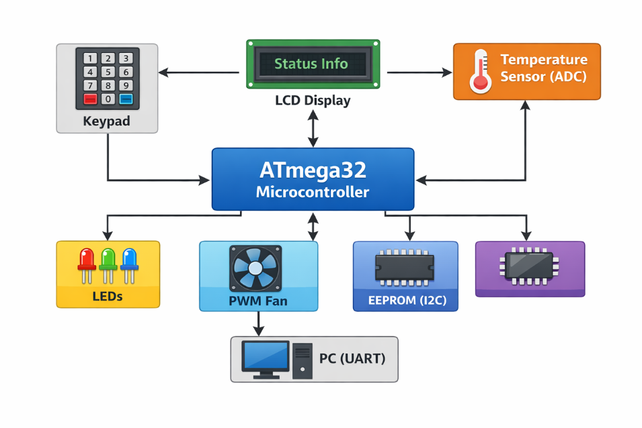
Block Diagram

Slide 6
Application
LCD
Keypad
Motor
LM35
EEPROM
GPIO
PWM
ADC
UART
I2C
Timer

Slide 7
Hardware Components and Connections
Microcontroller
ATmega32
Operates as the main processing and control unit
Utilizes GPIO, ADC, Timers, UART, and I2C peripherals

Slide 8
User Input Interface (Keypad)
A 4×4 keypad is used as the main user input device.
Connected to digital I/O pins
Configured using row–column scanning
Allows the user to:
Navigate the menu
Enter commands
Control LEDs
Adjust fan speed
Keypad scanning is performed periodically by the microcontroller using polling

Slide 9
Display Interface (LCD)
A 16×2 character LCD is used to display system information.
Displays:
Welcome screen
Menu options
LED status
Fan speed level
Real-time temperature
Connected in 4-bit or 8-bit mode
Controlled through GPIO pins
The LCD provides continuous feedback to the user.

Slide 10
Temperature Monitoring (ADC)
Temperature is measured using an analog temperature sensor connected to the ADC module.
Sensor output is an analog voltage
Connected to one ADC channel
ADC converts the signal into a digital value
Temperature is:
Displayed on the LCD
Sent to the PC through UART
ADC sampling is performed periodically.

Slide 11
Lighting Control (LEDs)
The system controls three LEDs, each representing an independent lighting unit.
Each LED is connected to a dedicated GPIO output pin
LEDs can be:
Turned ON or OFF individually
Controlled through keypad commands
LED states are:
Displayed on the LCD
Stored in EEPROM
This demonstrates basic digital output control.

Slide 12
LED Control Details (With Temperature Ranges)
The system uses three LEDs, each indicating a specific temperature range:
Green LED (Low Temperature) Turns ON when the temperature is below 25°C. This indicates safe and normal operating conditions.
Yellow LED (Medium Temperature) Turns ON when the temperature is between 25°C and 35°C. This represents a moderate temperature level.
Red LED (High Temperature Warning) Turns ON when the temperature is above 35°C. This indicates overheating and triggers a warning condition.
Only one LED is active at a time based on the current temperature reading.

Slide 13
Fan Control (PWM)
Fan speed control is implemented using Pulse Width Modulation (PWM).
The fan is driven using a PWM output from one of the ATmega32 timers
Fan speed is controlled by adjusting the PWM duty cycle
Multiple speed levels are available
Speed is selected via the keypad and displayed on the LCD
PWM provides efficient and smooth speed control.

Slide 14
Fan Control and Temperature Relation (With PWM Ranges)
The fan speed is automatically controlled based on the temperature using PWM:
Temperature < 25°C Fan runs at low speed PWM duty cycle ≈ 30%
Temperature between 25°C and 35°C Fan runs at medium speed PWM duty cycle ≈ 60%
Temperature > 35°C Fan runs at maximum speed PWM duty cycle ≈ 90–100%
This temperature-based control ensures efficient cooling while minimizing noise and power consumption. The fan speed and temperature are continuously displayed on the LCD and transmitted to the PC via UART.

Slide 15
UART Communication
UART is used to communicate with a PC terminal.
Baud rate configured in software
System sends:
Temperature readings
LED status
Fan speed
Used for monitoring and debugging
Communication is unidirectional or bidirectional depending on implementation.

Slide 16
Data Storage (I2C – EEPROM)
An external EEPROM is connected via the I2C protocol.
Used to store:
LED states
Fan speed
User preferences
Data is retained after power loss
Settings are restored on system startup
This ensures non-volatile storage.

Slide 17
System Operation Flow
System powers ON
LCD displays welcome screen
User enters commands via keypad
ATmega32 processes input
Devices (LEDs / fan) are controlled
Temperature is read and displayed
Data is sent to PC via UART
User settings are saved using I2C

Slide 18
Used Peripherals
Peripheral | Usage in Project
LCD | Display temperature, device status, menu options
Keypad Scanning | User enters password and selects commands
Timer | Timing delays, periodic updates
Input Capture | Can be used for door sensor or ultrasonic expansion
PWM | Control fan speed or LED brightness
ADC | Read temperature sensor (LM35)
UART | Send data to PC for monitoring/logging
I2C | Interface with RTC module or EEPROM storage

Slide 19
System Features
User Interface
Menu displayed on LCD
Keypad used for navigation and control
Temperature Monitoring
Temperature read using ADC
Displayed continuously
Device Control
LED ON/OFF
Fan speed control using PWM
Communication
UART sends temperature + device status to PC terminal
Data Storage
Settings saved in EEPROM through I2C

Slide 20
Example Scenario
User powers on system
LCD shows welcome screen
User enters password through keypad
User chooses:
Turn Light ON/OFF
Increase Fan Speed
Monitor Temperature
Data is transmitted to PC via UART
User settings are stored through I2C

Slide 21
Submission Requirements
Students must submit one compressed (.zip or .rar) file that contains the following folders:
Code Folder This folder must include:
All C source files
Header files
Drivers used in the project
Any configuration files

Slide 22
Proteus Simulation Folder This folder must include:
Proteus design file (.pdsprj)
Required library components if used
Project Demo Video Folder A short video (max 5 minutes) showing the project running clearly, including:
Full system operation
All required features
Demonstration of all cases and conditions
Proof that the project meets the specifications

Slide 23
Report Document
Report.pdf / Report.docx (Written in English)
The report must include:
Project overview
Hardware and software implementation details
Explanation of peripherals used
System workflow
Notes about any requirement changes
⚠️ If any component or feature was replaced, it must be clearly mentioned (with justification) — up to 5 pages maximum.

Slide 24
Team Requirements
Team size: from 1 to 3 members
Deadline
Submission deadline: within 2 weeks (From Jun16 Till Jun31)
Discussion
An offline discussion will be held (date will be announced later)

Slide 25
Conclusion
This project is a complete embedded system that demonstrates strong understanding of:
Digital I/O interfacing
Keypad scanning
LCD communication
ADC sensor reading
PWM motor/LED control
UART serial communication
I2C external module interfacing
Timer-based scheduling

Slide 26
Thank You!
Any questions?

